Slide 1
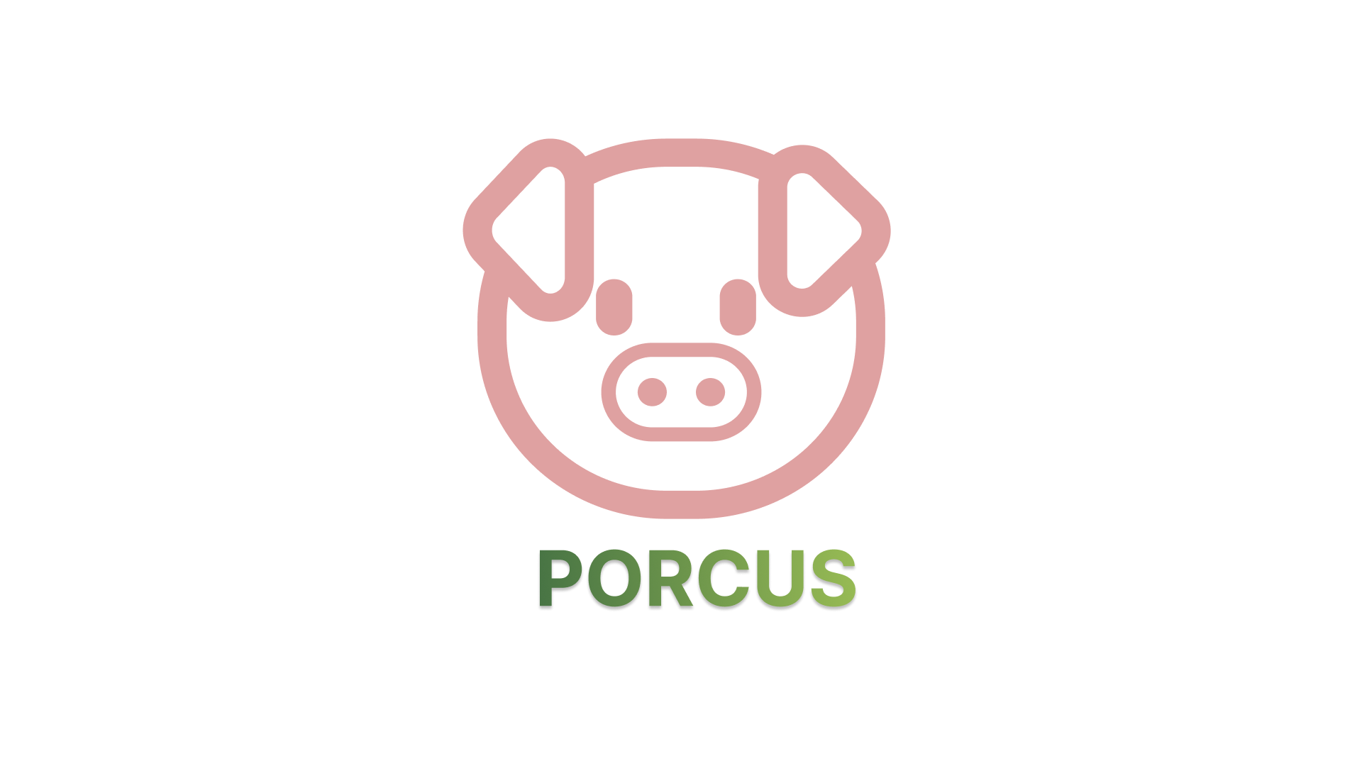
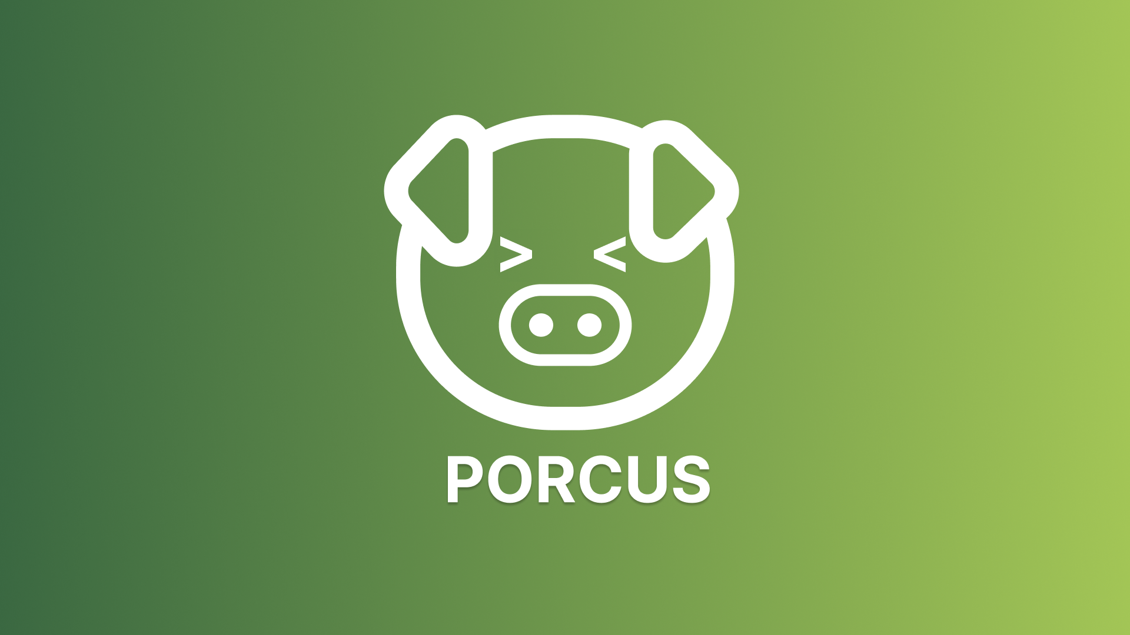

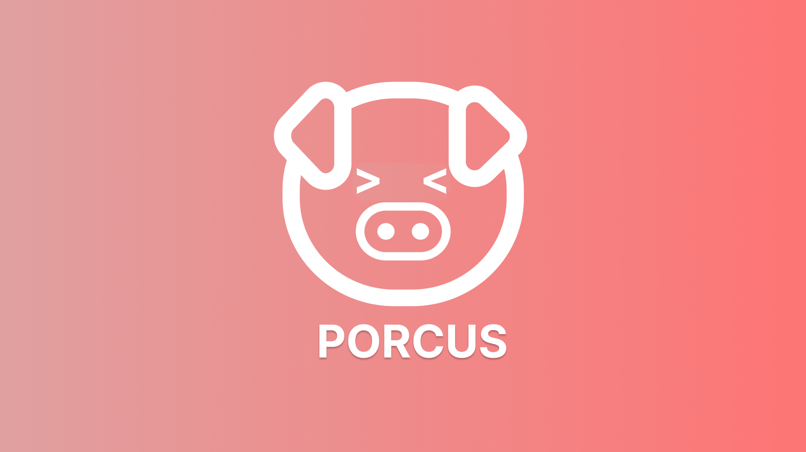

Slide 2




Project Description
A mobile application entitled "PORCUS: Backyard Piggery Management" which revolves managing pigs and schedules in a typical pig farming business, to help farmers with their daily farm transactions. With the use of this application, it will help farmers eliminate manual record tracking or keeping, and thus, would help limit waste by eliminating use of pen and paper.

Slide 3
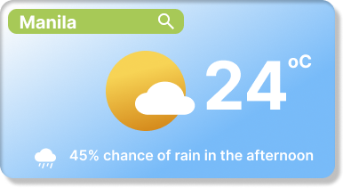

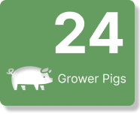
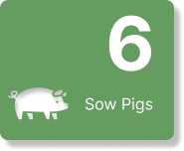

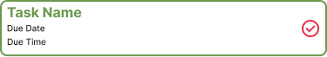


Home
The main page of the application. It contains weather forecast, task to do and number of pigs.

Slide 4



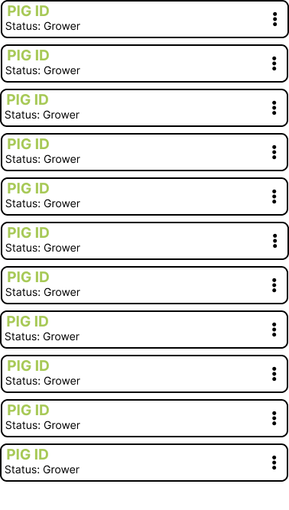
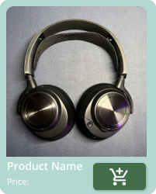
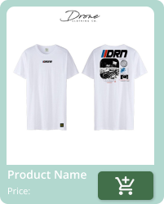
MANAGE PIGS
This page contains the pig registration, details and information for the user to identify each of individual.

Slide 5



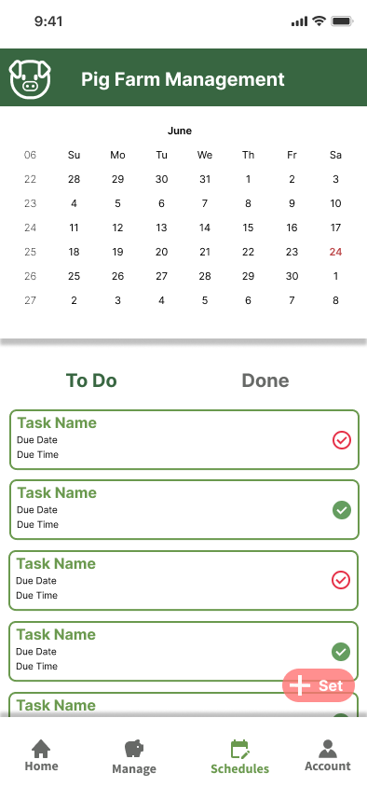
TASK NAME
DUE DATE
DUE TIME
TASK NAME
DUE DATE
DUE TIME
TASK NAME
DUE DATE
DUE TIME
TASK NAME
DUE DATE
DUE TIME
TASK NAME
DUE DATE
DUE TIME
TASK NAME
DUE DATE
DUE TIME
TASK NAME
DUE DATE
DUE TIME
TASK NAME
DUE DATE
DUE TIME
TASK NAME
DUE DATE
DUE TIME
TASK NAME
DUE DATE
DUE TIME
MANAGE PIGS
This page contains the pig registration, details and information for the user to identify each of individual.
This page shows the task that are pending and finished.
MANAGE TASK

Slide 6
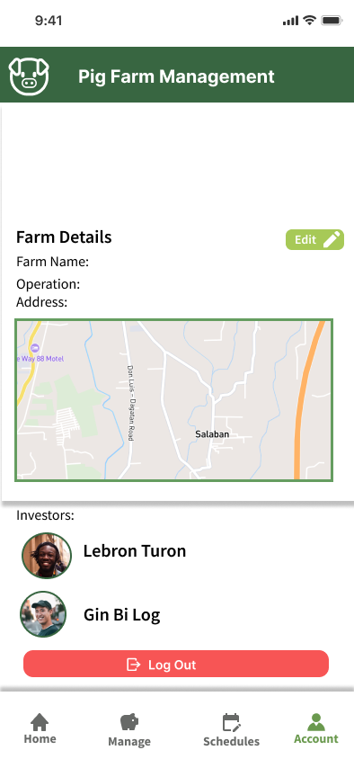
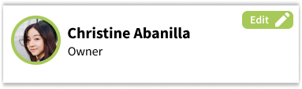
TASK NAME
DUE DATE
DUE TIME
TASK NAME
DUE DATE
DUE TIME
TASK NAME
DUE DATE
DUE TIME
TASK NAME
DUE DATE
DUE TIME
Account Tab
TASK NAME
DUE DATE
DUE TIME
This tab is for the user to change their personal information and farm details.
TASK NAME
DUE DATE
This page shows the task that are pending and finished.
DUE TIME
MANAGE TASK
TASK NAME
DUE DATE
DUE TIME
TASK NAME
DUE DATE
DUE TIME
TASK NAME
DUE DATE
DUE TIME
TASK NAME
DUE DATE
DUE TIME

Slide 7
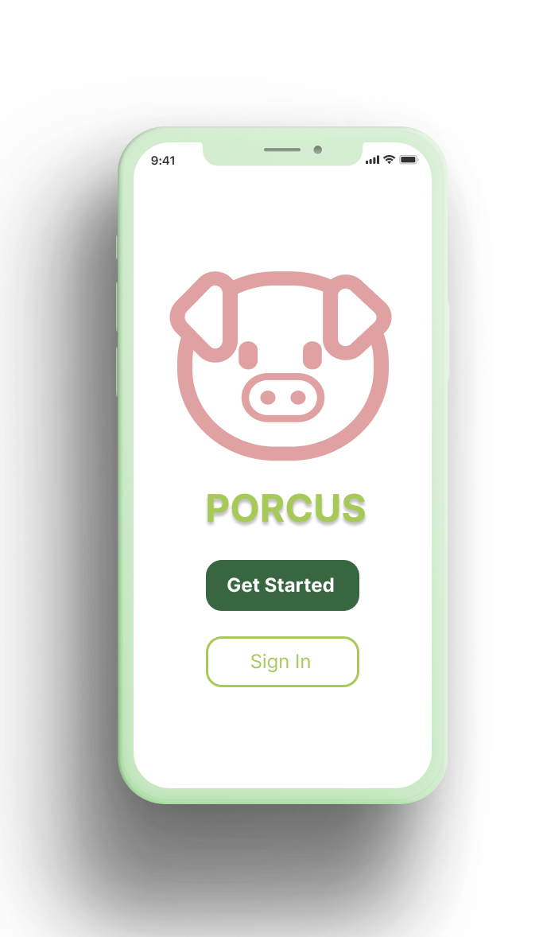

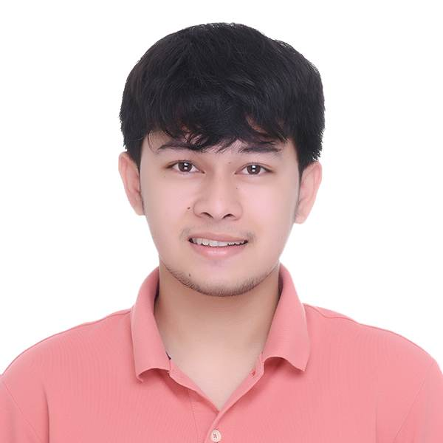
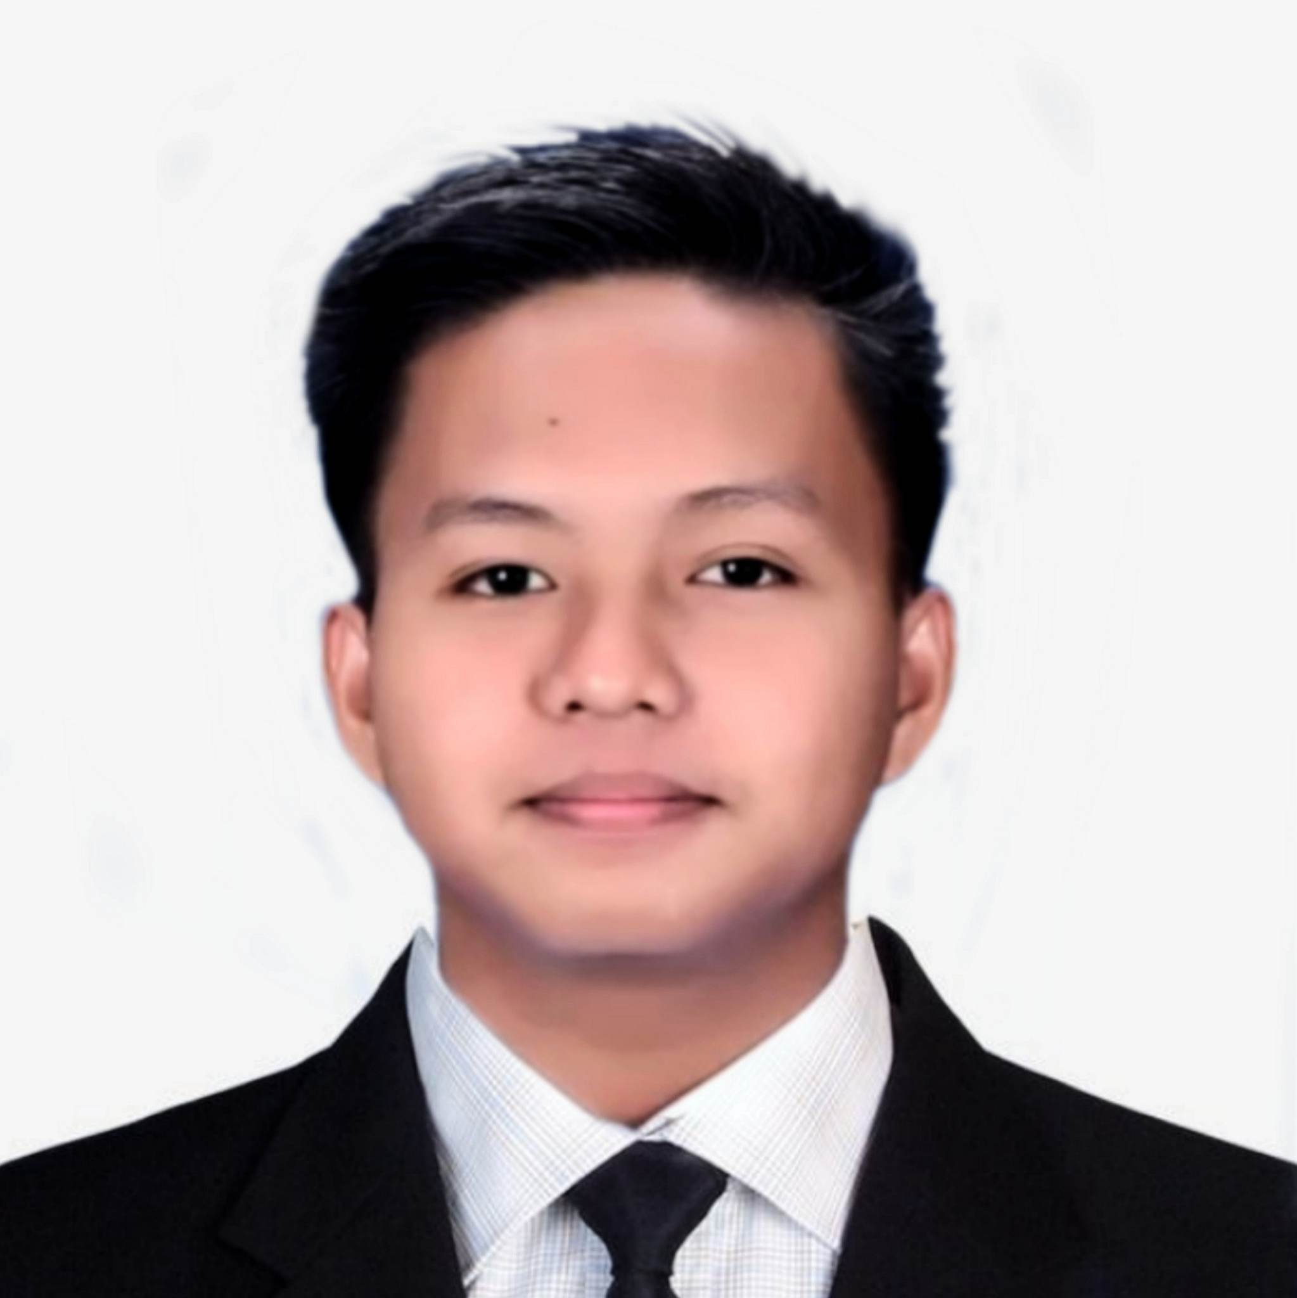
PORCUS
Account Tab
Backyard Pig Farming Application
Aclan, Jod Matthew P.
Rondero, Vincent Patrick S.
Salazar, Jasper D.

